Slide 1


CCMapper UI POC
07.06.2022

Slide 2
Index
Technologies Being Used
Description
Covered Points In POC
Screenshots

Slide 3
Technologies Being Used
Front-end
Angular io
Material(For Design)
Back-end
SpringBoot (Rest API)
Database
H2 (In-memory database)

Slide 4
Description
…..
….

Slide 5
Covered Points In POC
UI implementation using Angular is done for Company Table.
Rest API implementation is done which includes getDataPerPrimaryKey, getAllData, saveData, deleteData and updateData operations.
Insert data, delete data and update data operations working fine with success page.
Pagination,Filtering is added.

Slide 6
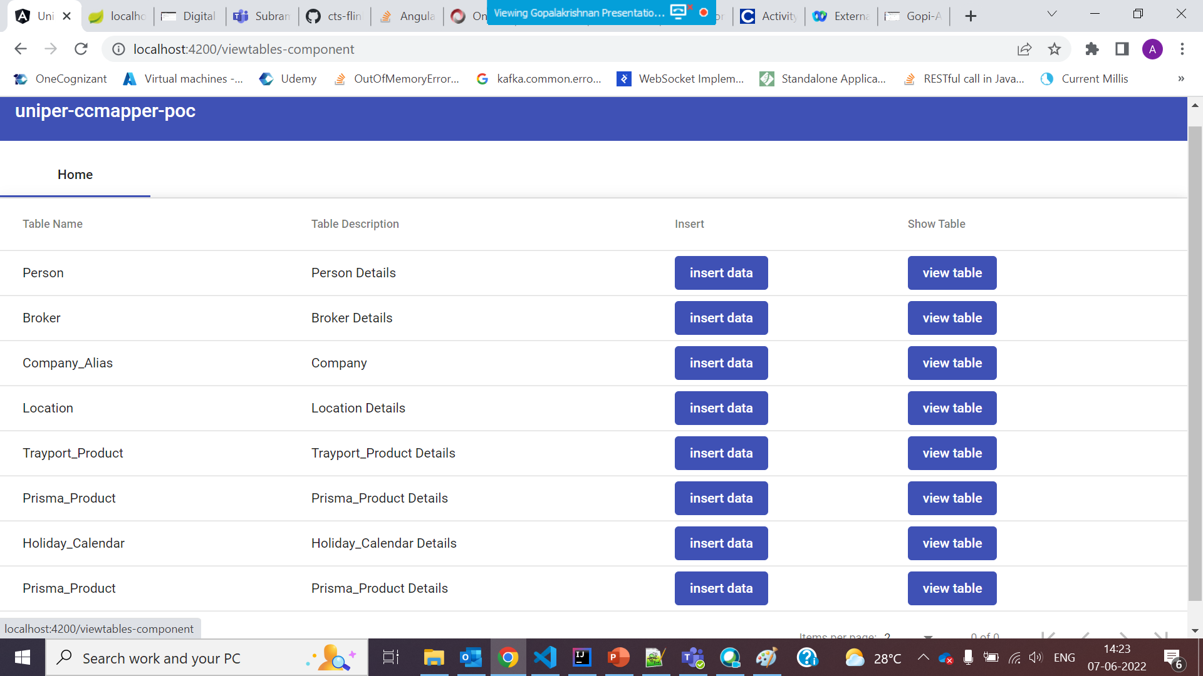
1.Landing Page

Slide 7
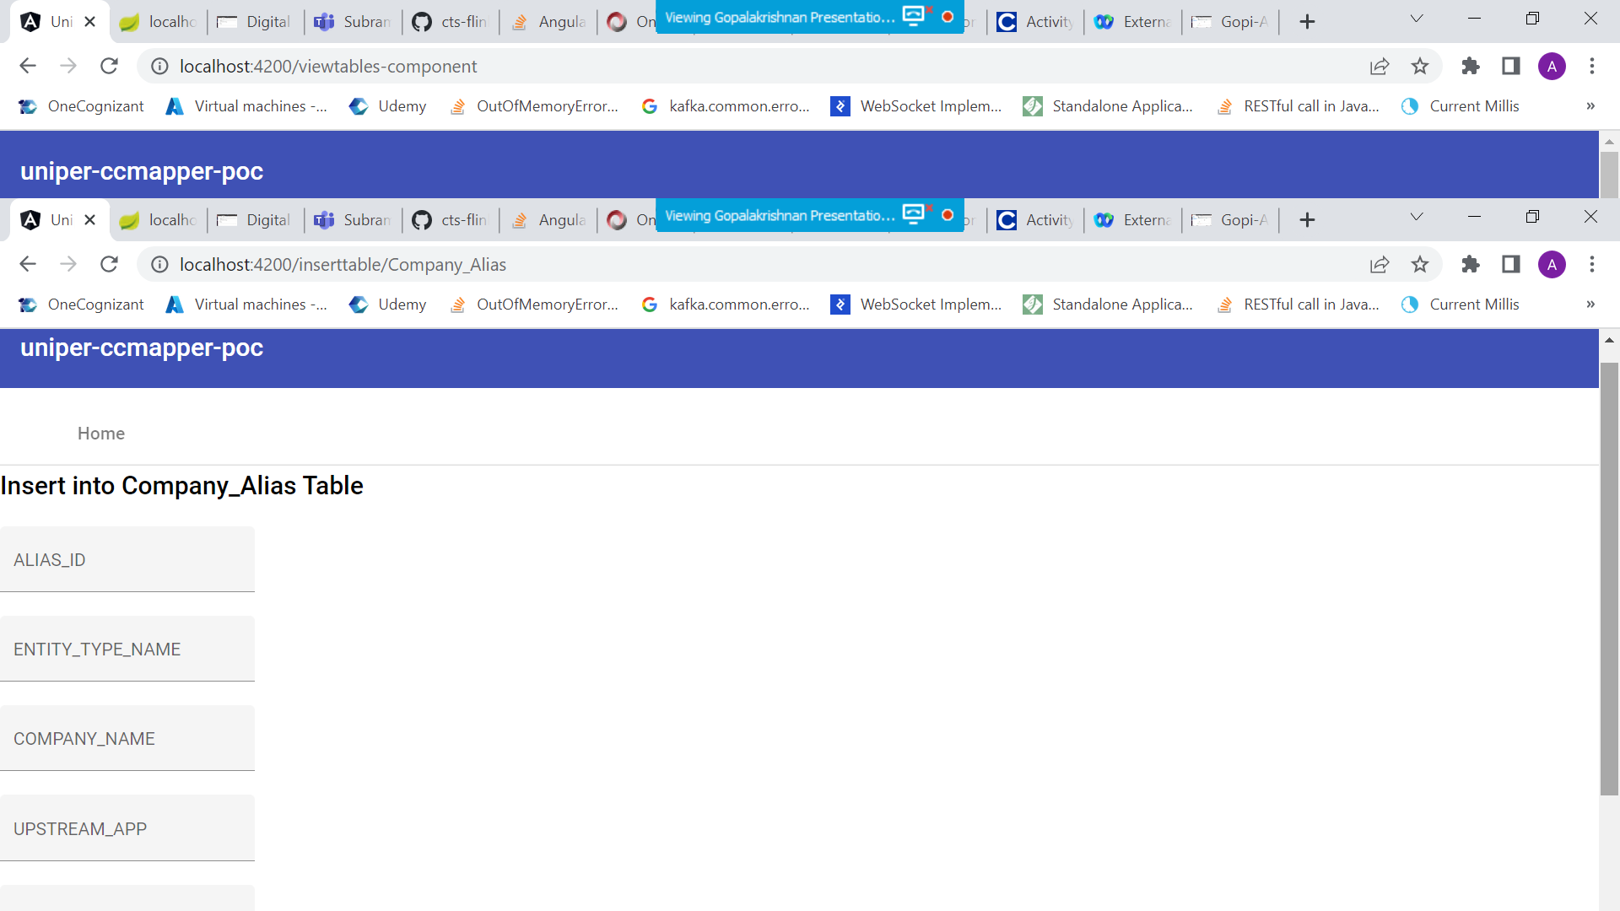
2.Insert Page for Company Table

Slide 8
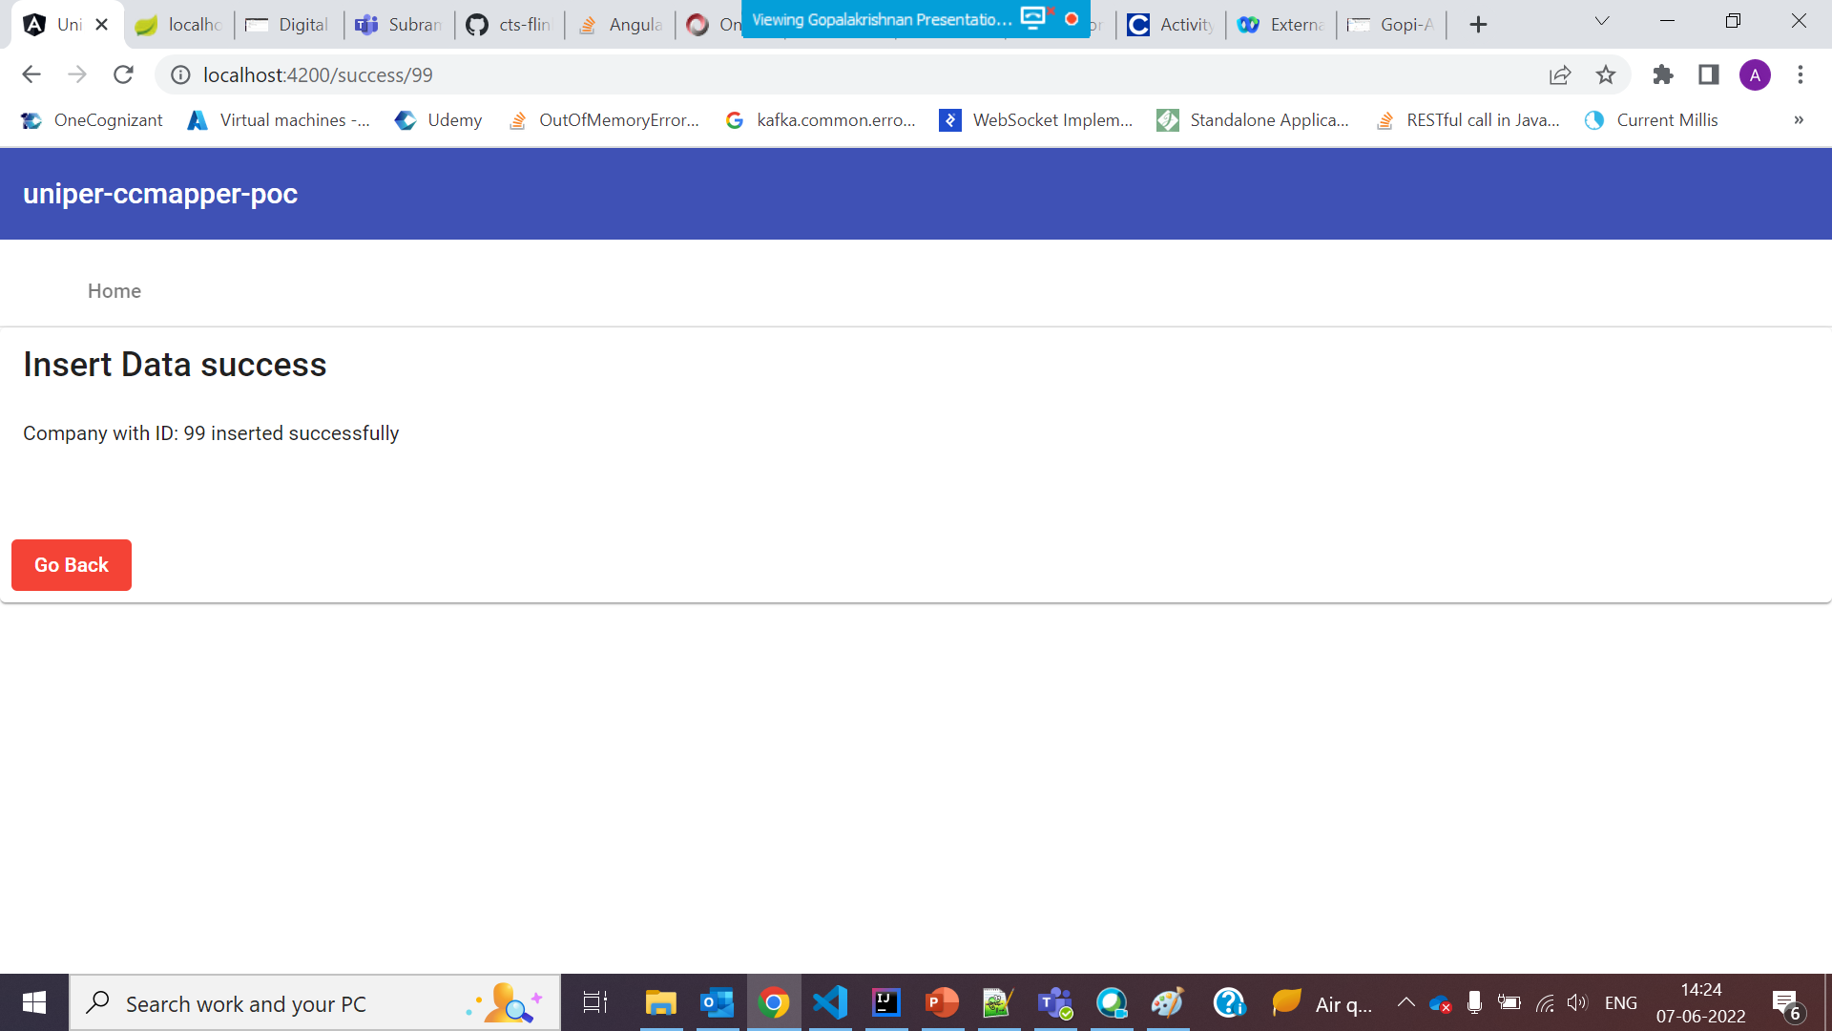
3.Confirmation for Success

Slide 9
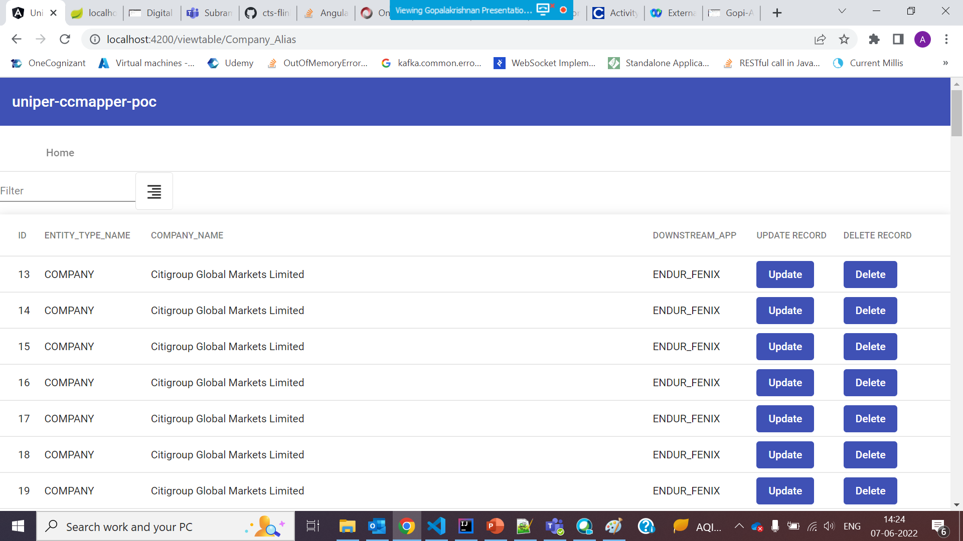
4.View Company Table data

Slide 10
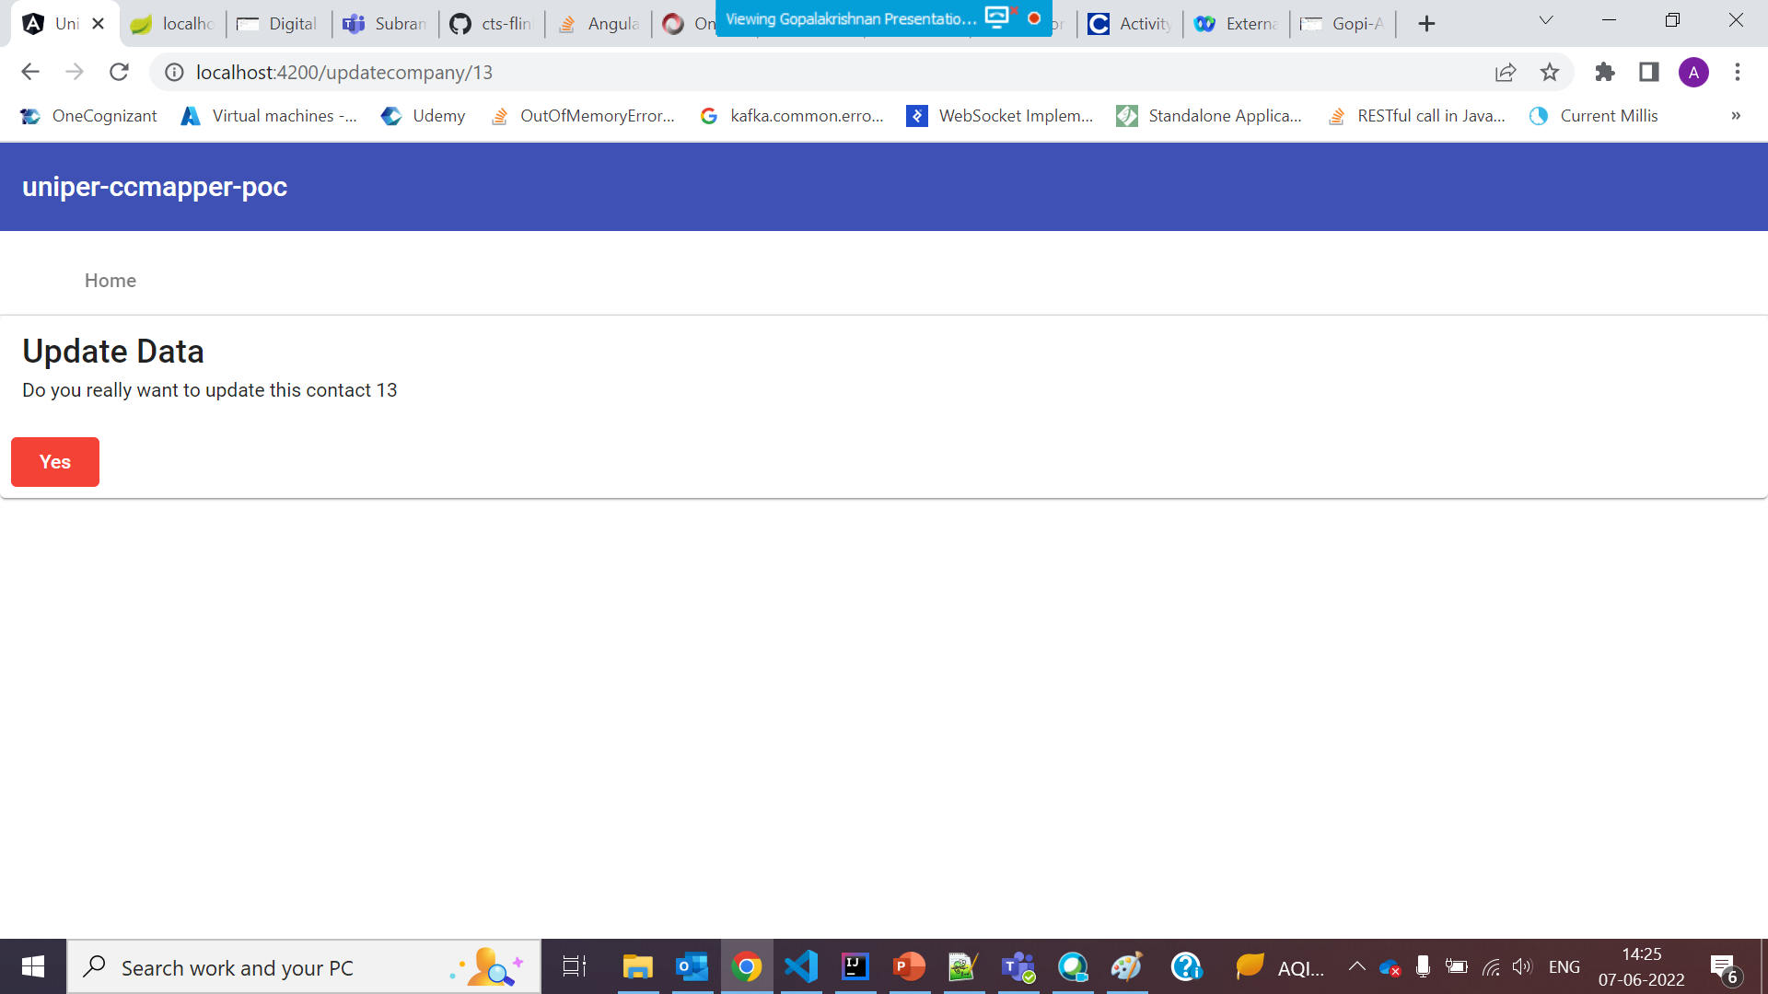
5.Consent Page For Updation

Slide 11
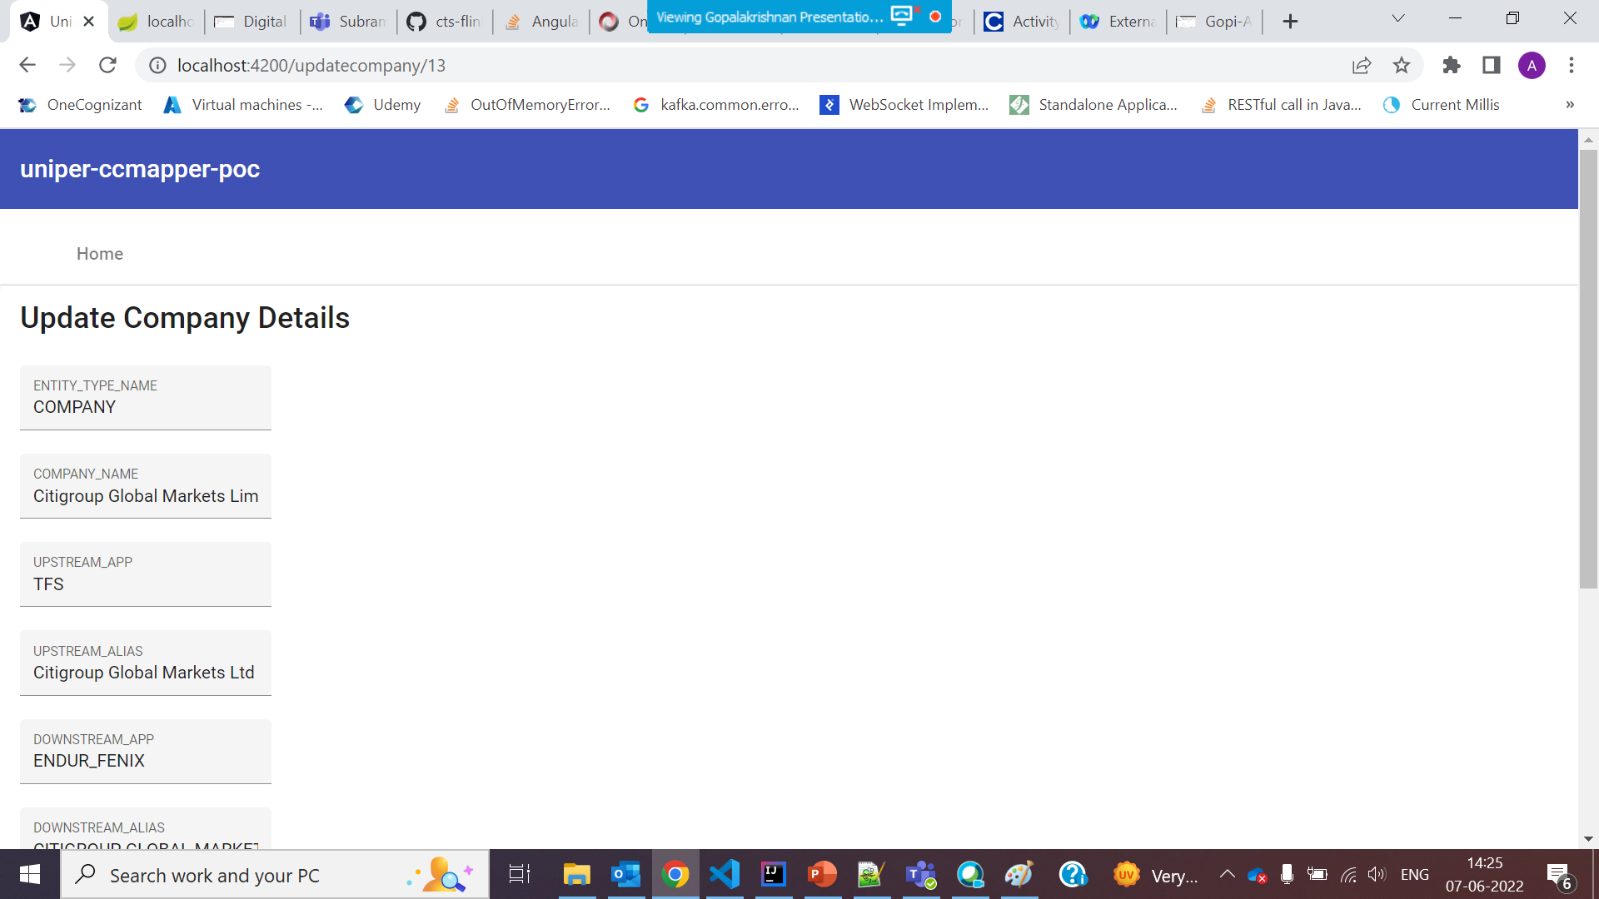
6.Update page with prepopulated data

Slide 12
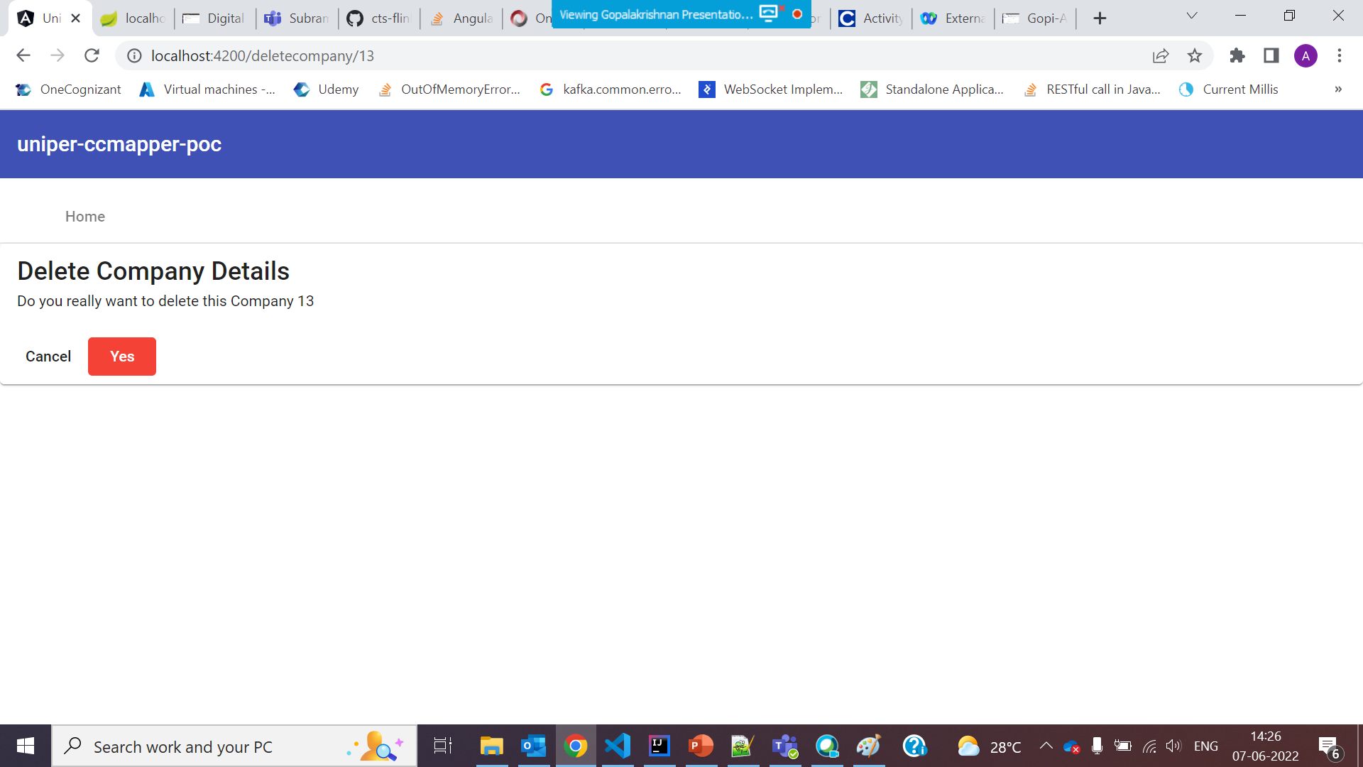
7.Consent For Delete data

Slide 13
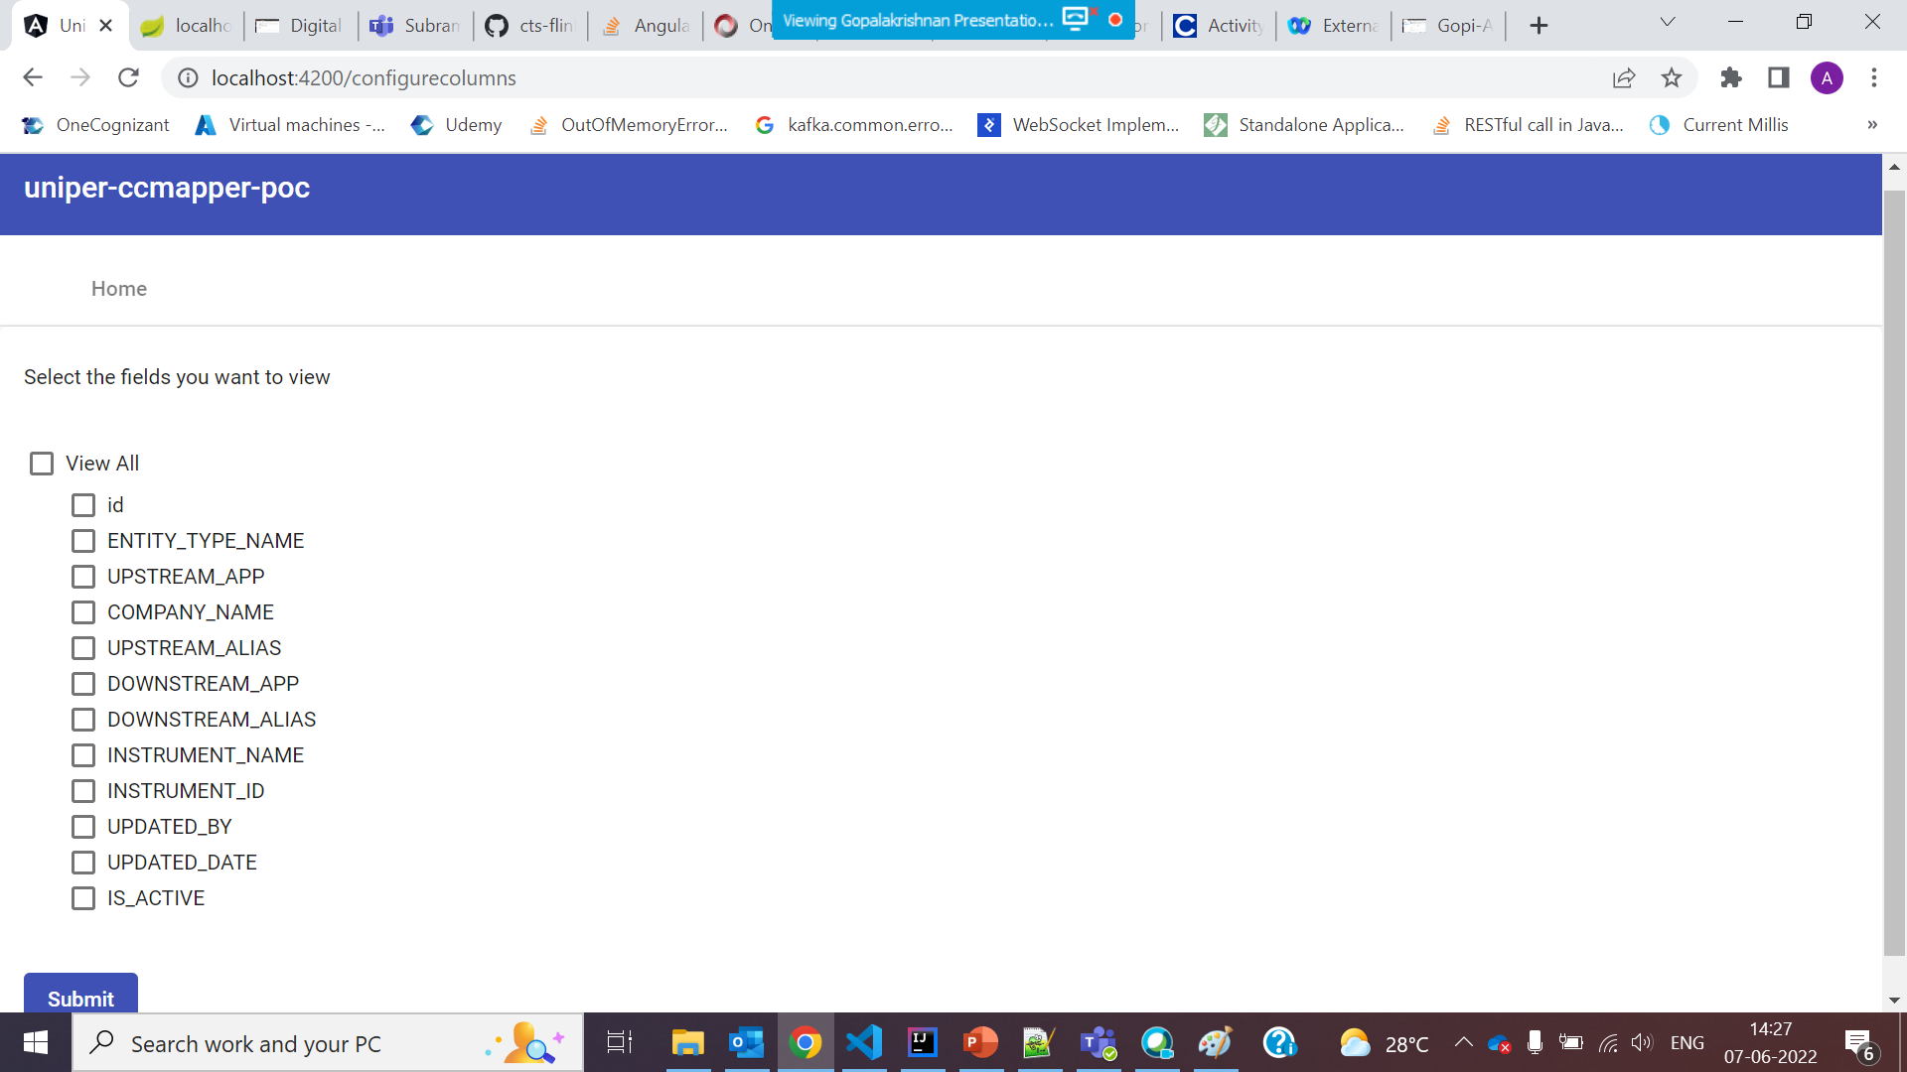
8.Configurable Column contents

